Slide 1

Smart Assessment Paper Generator Using AI
MUHAMMAD ZAKARIYA - 37581
MUHAMMAD MEHTAB - 37582
MUHAMMAD SUBHAN – 37819
Supervised by: Ms. Sadia Zar
Computing and Technology Department, IQRA University Islamabad – H9 Campus - Pakistan

Slide 2

Table of Content
INTRODUCTION
PROBLEM STATEMENT
OBJECTIVES
PROJECT RATIONALE
RELATED WORK
DATASET & TOOLS
PROPOSED METHODOLOGY /ARCHITECTURE
EXPERIMENTAL RESULTS
CONTRIBUTION & FUTURE WORK
REFERENCES

Slide 3
Introduction
The Smart Assessment Paper Generator Using AI leverages Large Language Models (LLMs) to automate academic assessment processes.
It generates question papers, assignments, and quizzes from course content, aligns them with CLOs/PLOs, and provides adaptive tutoring and feedback.
This intelligent system aims to modernize education through automation, personalization, and efficiency.

Slide 4
Problem Statement
Traditional paper generation and grading processes are time-consuming, inconsistent, and error-prone.
Teachers struggle to create balanced assessments aligned with CLOs/PLOs, while students lack personalized feedback.
Existing tools offer limited automation, lack integration, and often require paid access.
There is a need for an AI-powered, integrated, and affordable academic solution.

Slide 5
Aims &Objectives
Aim:
To develop an AI-driven platform that automates question paper generation, evaluation, and personalized tutoring.
Objectives:
To Design a smart module utilizing LLMs to generate question papers, assignments, and quizzes automatically from uploaded course content, graded on three difficulty levels (Easy, Medium, and Hard).
To Map all the questions generated to Course Learning Outcomes (CLOs) and Program Learning Outcomes (PLOs) to ensure educational relevance and assessment integrity.

Slide 6
Aims &Objectives
To Deploy an AI-powered assessment system that can grade objective and subjective questions and give immediate, feedback to students for ongoing improvement.
To Develop an adaptive tutoring module that will review student performance and recommend specific study material or mock tests to cover individual weaknesses.

Slide 7
Aims &Objectives
To Utilize student performance data and AI-based analytics to offer tailored career advice and counselling suggestions based on strengths and academic passion.
To Design a multi-role system (Admin, Teacher, Student) with secure authentication, easy-to-use dashboards, and role-based access.
To Design a cloud-based, cross-platform system that is cost-effective for schools and expandable to handle large user numbers and datasets.

Slide 8
Project Rationale
Manual assessment creation is tedious and inefficient.
This project introduces automation using AI to save educators’ time, enhance assessment consistency, and improve student outcomes.
It bridges the gap between technology and education by providing a complete, affordable, and adaptive system for learning institutions

Slide 9
Related work
Work/ Application | Research Gap/ Purpose | Application Area | Link / Reference | Underlying Models / Techniques Used | Strengths | Weaknesses
Quizbot (2024) | Existing tools lack multimodal input (video, PDF, image) and adaptive Bloom-level tagging. | AI-based Quiz and Question Generation | https://quizbot.ai | Uses NLP and Transformer models for contextual question creation from various content sources. | Generates questions from PDFs, PPTs, videos, and images; supports Bloom’s Taxonomy; allows customization. | Limited free tier; export and analytics options are paid; limited CLO/PLO-level tagging
Revisely AI Quiz Generator (2024) | Lack of integrated AI tools for teachers to instantly convert learning materials into assessments. | AI-based Quiz and Question Generation | https://www.revisely.com/quiz-generator | NLP-based context extraction and question generation from documents. | Converts notes, textbooks, PDFs, and slides into quizzes within seconds; intuitive and free to test. | Limited question customization; no detailed feedback analytics; lacks topic-based filtering.

Slide 10
Related work
Musely AI Question Paper Generator (2024) | Lack of integrated AI tools for teachers to instantly convert learning materials into assessments. | AI Quiz Generation for Educational Use | https://www.revisely.com/quiz-generator | NLP-based context extraction and question generation from documents. | Converts notes, textbooks, PDFs, and slides into quizzes within seconds; intuitive and free to test. | Limited question customization; no detailed feedback analytics; lacks topic-based filtering.
Wayground (2025) | Traditional quiz tools did not fully support uploading varied content (documents/websites/links) and automatic generation of assessments. (support.wayground.com) | AI-powered Prep & Quiz Generation Platform | https://www.wayground.com/?lng=en | Combines AI question generation, document/URL upload, web content import, standard/curriculum alignment. (support.wayground.com) | Allows upload of documents/websites to generate quizzes; supports standard-alignment and editing; very flexible. | Free tier may be limited; some features may require login; advanced analytics may be paid.

Slide 11
Related work
Questgen (2024) | Many tools lacked broad question-type support (higher order, matching, image-to-quiz) and export into multiple formats. (Questgen - AI Quiz Generator) | AI Quiz/Assessment Generator | https://www.questgen.ai/?utm_source=chatgpt.com | Supports multiple question types (MCQ, True/False, Fill in the Blank, Matching, Higher Order), multimedia input, export in PDF/CSV/XML. (Questgen - AI Quiz Generator) | Very comprehensive tool; supports many formats; good for large scale question generation. | Free plan has limits; might require payment for full features; may have learning curve.

Slide 12
Gap Analysis for Development-Based Project
Current Gaps: • Lack of personalization and CLO/PLO alignment • Limited automation in evaluation and tutoring • Poor scalability and security in existing tools
Proposed Solution: • Unified AI system integrating LLM-based question generation, KNN grading, adaptive tutoring, and career guidance. • Cloud-hosted, open-access, role-based platform ensuring data security and affordability
.
Area | Current State (What Exists) | Identified Gap / Limitation | Proposed Solution (Your App Contribution)
User Needs | Teachers and students currently rely on generic learning or quiz-generation tools with minimal academic alignment. | Lack of personalization, no CLO/PLO mapping, and limited relevance to institutional curriculum. | Develop a personalized, outcome-based assessment system that adapts to user roles (Teacher, Student, Admin) and aligns with CLOs/PLOs for each course.

Slide 13
Gap Analysis for Development-Based Project
Functionality | Existing tools mainly offer basic question generation without integration of evaluation, tutoring. | Absence of a unified solution that combines paper generation, feedback, and AI-based analysis. | Implement an integrated LLM-based framework that automates question generation, grading, tutoring, and career counselling within one platform.
Usability (UI/UX) | Current educational AI tools have complex or non-intuitive interfaces designed mainly for technical users. | Teachers and students face difficulty in navigation and accessing required modules. | Design a simple, responsive web interface with dashboards for each user role and intuitive access to all modules (Paper Generation, Feedback, Performance, Career Guidance).

Slide 14
Gap Analysis for Development-Based Project
Performance & Scalability | Existing systems slow down when handling large question banks or multiple concurrent users. | Limited scalability and slow performance in real-time operations. | Use cloud-based backend architecture (e.g., Firebase/AWS) with optimized AI processing pipelines to ensure real-time generation and scalability for institutions.
Security & Privacy | Some current systems store user data insecurely or lack multi-level access control. | Potential data breaches and privacy risks, especially with student academic data. | Implement role-based authentication, encrypted communication, and secure data storage, ensuring compliance with academic privacy standards.

Slide 15
Gap Analysis for Development-Based Project
Cost / Accessibility | Most advanced tools such as PrepAI or Eklavvya are paid platforms with limited free access. | High subscription costs prevent small institutions or individual users from accessing the service. | Develop a web application that is cost-effective, open-access using Python and open-source AI models, and make it affordable and accessible for all users.

Slide 16
Dataset and Tools
Frontend: React.js
Backend: Python (Flask/Django)
Database: Firebase / MySQL
AI Tools: GPT (LLM), KNN, NLP
Other: HTML, CSS, JavaScript, VS Code, GitHub
Hosting: Firebase / AWS Cloud

Slide 17
Dataset and Tools
Dataset Names with Links
EduQG Dataset – LLM Science Exam Format (~3.4K) https://www.kaggle.com/datasets/nlztrk/eduqg-dataset-llm-science-exam-format-34k
Question Answer Dataset https://www.kaggle.com/datasets/rtatman/questionanswer-dataset
ARC (AI2 Reasoning Challenge) – Grade School Science Questions https://www.kaggle.com/datasets/thedevastator/arc-grade-school-science-questions
Astronautics Multiple Choice Questions and Answers https://www.kaggle.com/datasets/patrickfleith/astronautics-multiple-choice-questions-and-answers
Question Type Classification Dataset https://www.kaggle.com/datasets/ananthu017/question-classification

Slide 18
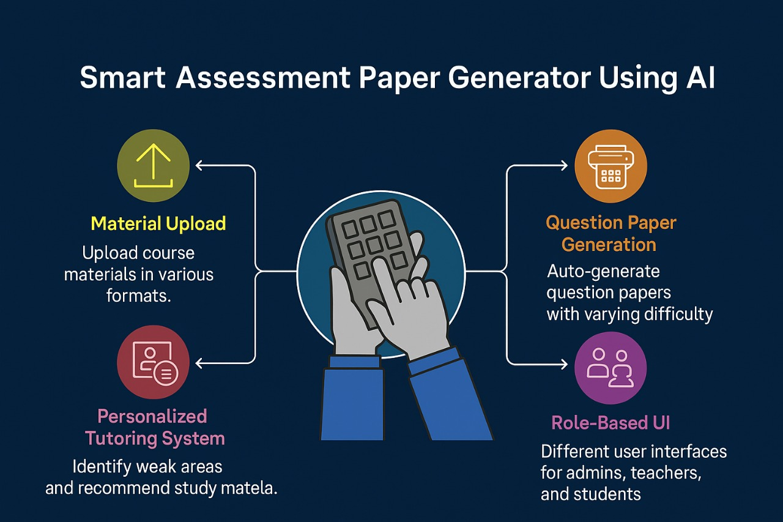
Proposed Methodology/Architecture
Methodology Steps:
Requirement Analysis
Data Collection & Preprocessing
System Design & Development
Integration & Testing
Deployment & Evaluation
Architecture Layers: Input Layer → AI Processing Layer (LLM + KNN)
→ Application Layer → Database Layer → Security Laye

Slide 19
System Modules
Question Generation: LLM-based, generates Easy/Medium/Hard questions from course material.
Evaluation Module: Grades objective and subjective questions using NLP & KNN.
Personalized Tutoring: Recommends learning materials and mock tests.
Career Counselling: Provides career suggestions using performance data.
Role Management: Admin, Teacher, and Student access with dashboards

Slide 20
Contribution & Future Work
Contributions: • First integrated AI system for assessment and personalized tutoring. • Cost-effective, scalable, and outcome-aligned solution.
Future Work: • Add voice and multimodal input support. • Integrate plagiarism detection and AI ethics checks. • Expand mobile compatibility and regional language support.

Slide 21
References
[1] A. Kurdi, M. Leo, and J. Alshehri, “A systematic review of automatic question generation for educational purposes,” International Journal of Artificial Intelligence in Education, vol. 30, no. 4, pp. 1–28, 2020, doi: 10.1007/s40593-019-00186-y.
[2] S. Zhao, A. Khashabi, and D. Roth, “Transformer-based question generation for educational assessment,” arXiv preprint arXiv:2309.15004, 2023, doi: 10.48550/arXiv.2309.15004.
[3] N. Mulla, “Automatically generated short-answer questions using transformer and BERT-based models,” Frontiers in Artificial Intelligence, vol. 6, pp. 1–12, 2023.
[4] S. Maity, S. Choudhary, and K. Roy, “Leveraging in-context learning and retrieval-augmented generation for academic question generation,” Proceedings of the International Conference on Artificial Intelligence in Education (AIED 2024), ACM, 2024.

Slide 22
References
[5] L. Furze, J. Reilly, and A. Young, “Artificial Intelligence Assessment Scale (AIAS): Evaluating the impact of GenAI-supported assessment frameworks,” arXiv preprint arXiv:2403.14692, 2024.
[6] M. Kumar and R. Gupta, “An intelligent tutoring framework using deep learning for personalized feedback,” IEEE Access, vol. 12, pp. 23540–23552, 2024.
[7] PrepAI, “AI-powered question paper generator,” Online. Available: https://www.prepai.io. [Accessed: Oct. 2025].
[8] EdutorAI, “Smart AI-based quiz generation and self-assessment tool,” Online. Available: https://www.edutorai.com. [Accessed: Oct. 2025].
[9] Eklavvya, “AI-based question paper generation and exam management platform,” Online. Available: https://www.eklavvya.com. [Accessed: Oct. 2025].

Slide 23
THANK YOU
Questions are welcome!
“Smart Students Smart Assessment ”

